Slide 1
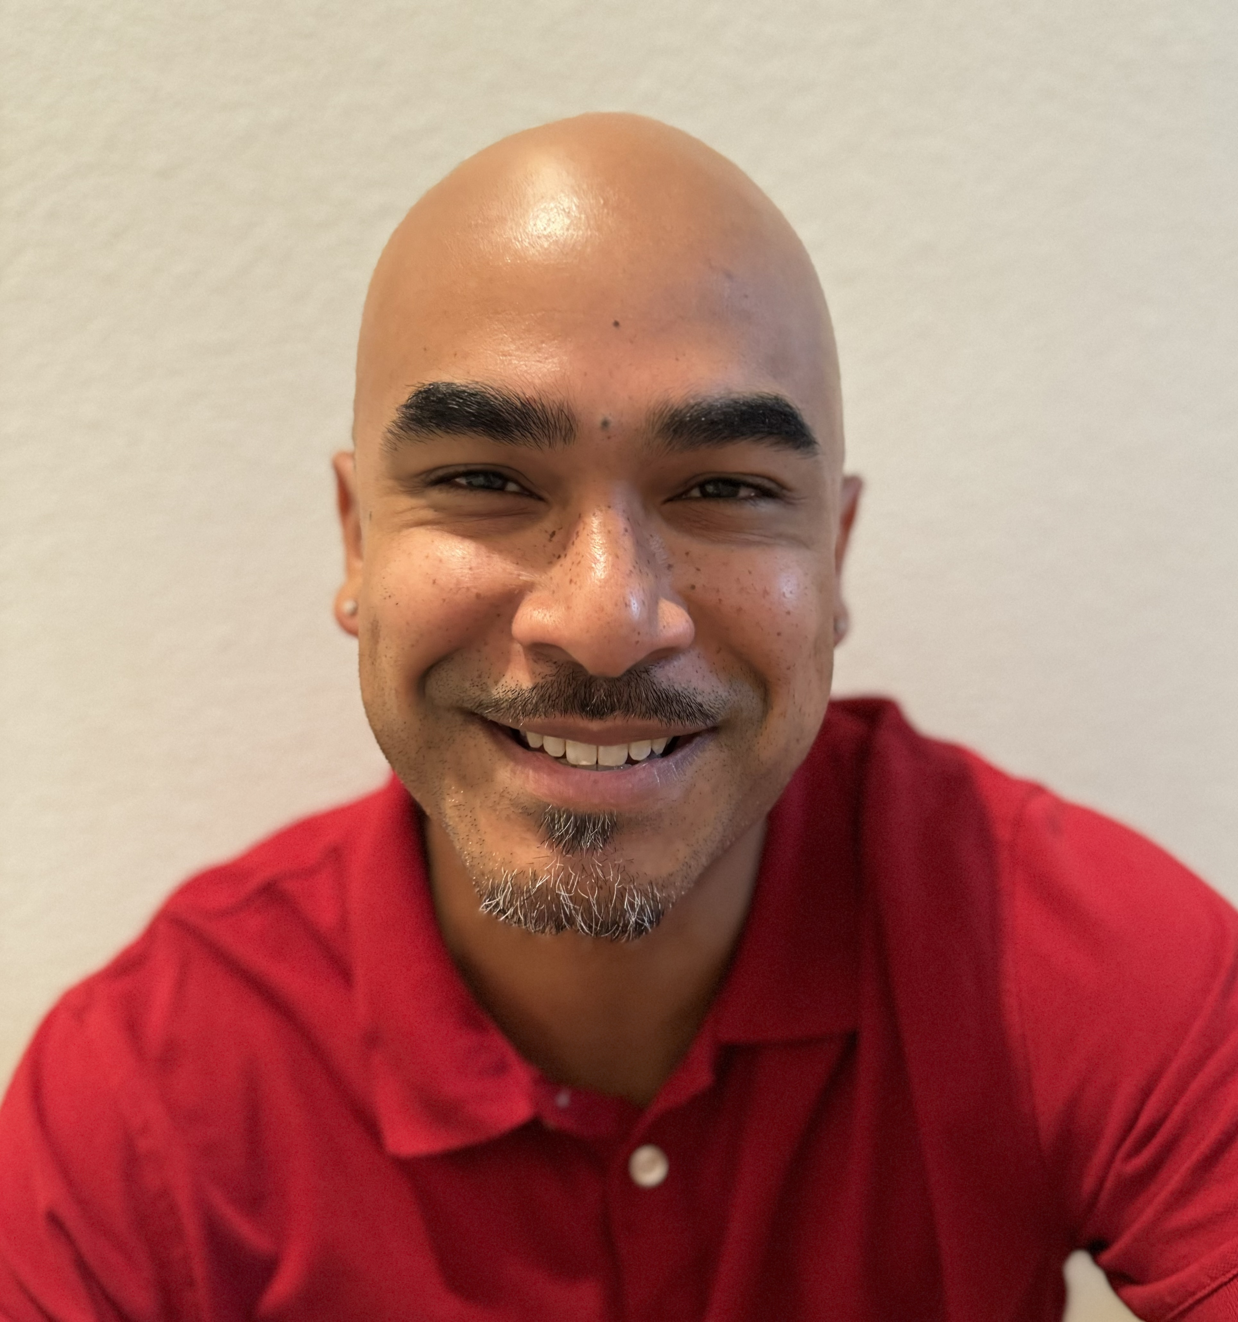
Ramon Guerrero Sr. Manager — Cloud & Product
Email
ramon.guerrero@thebridge.com
Location
Tampa, Florida
Mobile
(720) 883-4399
Ramon joined The Bridge in August 2024. He brings extensive knowledge of back-end and front-end technologies, along with industry-wide best practices, to help teams learn and grow.
EXPERIENCE
Industry Experience
Education | Government | Automotive | Healthcare | Food | Retail | Ceramics
Azure Migration | Education
Led a team in modernizing nine legacy .NET applications
Upgraded each application to .NET 4.8
Implemented a shared library with integrations into Azure AD and App Insights that was used across each application
Migrated all nine applications to Azure
Provided client with an architectural overview of the migration with repeatable, step-by-step processes
Architecture Assessment Application | Government
Led the front-end in developing a multi-step architecture assessment application
Implemented a JSON-driven custom wizard to guide users through a series of questions around architecture specifications
Utilizing Three.js, built a custom 3D model viewer that allowed users to upload 3D asset to be viewed in-browser for review, prior to submission
BACKGROUND
Functional Skills
Full-stack Developer, .NET, C#, C++, PHP, React, Vue, DirectX, OpenGL, SQL Server, MySQL, DDD, CQRS, Micro Services, Linux, MacOS, Windows
Qualifications
With over 15 years of experience, Ramon is proficient across various technologies spanning from back-end to front-end development. He is well known for his ability to personalize experiences for his clientele with a love and passion for his profession. Ramon brings a positive and honest outlook to every experience he is a part of.

Slide 2

Email
ramon.guerrero@thebridge.com
Location
Tampa, Florida
Mobile
(720) 883-4399
Ramon joined The Bridge in August 2024. He brings extensive knowledge of back-end and front-end technologies, along with industry-wide best practices, to help teams learn and grow.
Ramon Guerrero Sr. Manager
Cloud & Product

Slide 3
Ramon Guerrero Sr. Manager — Cloud & Product
Email
ramon.guerrero@thebridge.com
Mobile
(720) 883-4399
Location
Tampa, Florida
BACKGROUND
EXPERIENCE
Functional Skills
Full-stack Developer, .NET, C#, C++, PHP, React, Vue, DirectX, OpenGL, SQL Server, MySQL, DDD, CQRS, Micro Services, Linux, MacOS, Windows
Qualifications
With over 15 years of experience, Ramon is proficient across various technologies spanning from back-end to front-end development. He is well known for his ability to personalize experiences for his clientele with a love and passion for his profession. Ramon brings a positive and honest outlook to every experience he is a part of.
Industry Experience
Education | Government | Automotive | Healthcare | Food | Retail | Ceramics
Azure Migration | Education
Led a team in modernizing nine legacy .NET applications
Upgraded each application to .NET 4.8
Implemented a shared library with integrations into Azure AD and App Insights that was used across each application
Migrated all nine applications to Azure
Provided client with an architectural overview of the migration with repeatable, step-by-step processes
Architecture Assessment Application | Government
Led the front-end in developing a multi-step architecture assessment application
Implemented a JSON-driven custom wizard to guide users through a series of questions around architecture specifications
Utilizing Three.js, built a custom 3D model viewer that allowed users to upload 3D asset to be viewed in-browser for review, prior to submission

